Slide 1
TERRORISM IN SOUTH ASIAN NATIONS

Slide 2
Terrorism
Terrorism refers to the unlawful use of violence and intimidation, especially against civilians in the pursuit of political aims.
It is one such problems which has crippled the nation today and the forces of the nation are trying very hard to protect itself from this.
The number of terrorist have increased throughout the years and also their violent acts.

Slide 3
About the Report
Analysis of the terrorism and various figures and facts using ‘Data Analytics and Statistical Tool’ i.e. R (or R Language).
Raw Data Set -> R Language -> Graphs and Charts.

Slide 4
Objectives
TO ANALYSE
Objective 1: Total ARM sales by south Asian nations.
Objective 2: Comparison of number of attacks on various South Asian Countries.
Objective 3: Rise and fall of terrorist attacks on various countries throughout the years.
Objective 4: Number of Casualties reported in various types of terrorist attacks.
Objective 5: Comparison of types of weapon used to carry out the attacks.

Slide 5
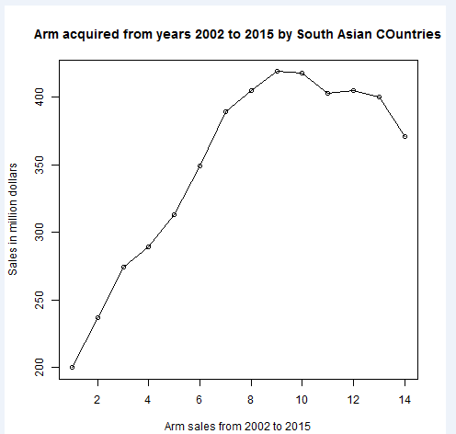
Objective 1 Total ARM acquired by south Asian nations
Imports for arms Increasing till 2010 and then decreasing.
Buying of arms.
Arms purchase increasing by various groups.
Needs to be stopped.
This is Official so could be by governments but how they utilize is important
Reports suggest illegal funding to the terrorists.

Slide 6
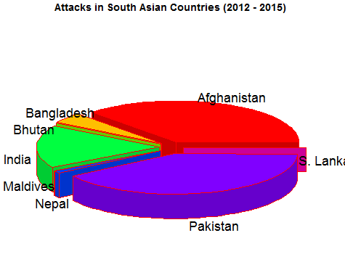
Objective 2 Comparison of number of attacks on various South Asian Countries.
Majority in Afghanistan, Pakistan and then India.
Contributing about 85-90 %
Rest of attacks on SA about 10%
Control Required as the values are not less
Shocking – Number of attacks is at par then imagination about 18000 attacks in total and that also in 4 years.

Slide 7
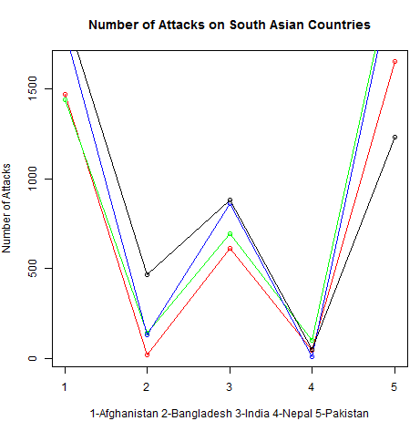
Objective 3 Rise and fall of terrorist attacks on various countries throughout the years.
Objective 2 year wise
Top 5 countries based on attacks from 2012 to 2015
RED=2012, GREEN=2013, BLUE=2014, BLACK=2015
Clearly attacks rising for all countries but for India and Nepal is constant
Rest for Afghanistan, Bangladesh and Pakistan, attacks increasing
New Polices or Administration could be behind reduction of these attacks by India and Nepal.
Still work needed to stop attacks.

Slide 8
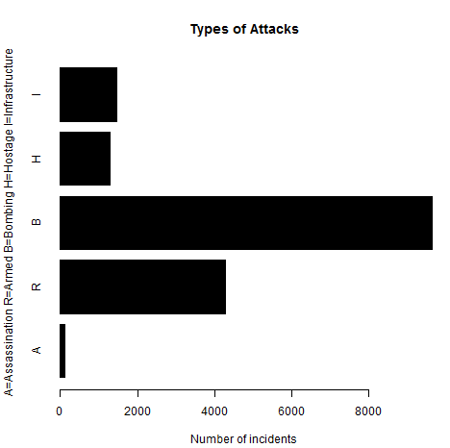
Objective 4 Number of Casualties reported in various types of terrorist attacks.
Types of Attacks and their focus
Bombing and armed attacks on top with more than 8000 cases
NO Objectives behind many of these but just for creating FEAR.
Infrastructure attacks like one on TAJ MAHAL in MUMBAI and Hostage less
Assassinations least about 100.
To stop this need to have Security Forces to be active and react on anything or any person suspicious.

Slide 9
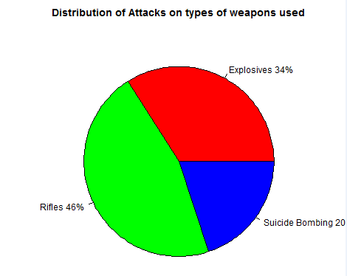
Objective 5 Comparison of types of weapon used to carry out the attacks.
Broadly categorized into 3
Assaults through Rifles, Explosives and Suicide Bombings.
Terrorists prefer Rifles over explosives and suicide bombings
Surveys tell AK-47 to be most preferred of Rifles since cheap and easy to assemble
Molotov's preferred as cheap for light explosions and Dynamite for Large explosions.
To stop terrorism need to control manufacture and sales by governments on rifles and explosives.

Slide 10
Possible solutions which are implemented
Need strict laws for purchase and illegal selling of arms.
Active Police Personal patrolling 24x7 for securing the entry points for terrorists in the border areas.

